Slide 1
TOKOPEDIA DRIVES MOBILE GROWTH IN SOUTHEAST ASIA BY PARTNERING WITH INMOBI
Tokopedia is Indonesia’s biggest online marketplace. It enables individuals and business owners in Indonesia to open and maintain their online stores giving its shoppers the convenience to choose from millions of products at best prices.

Slide 2
R E A L
R E S U L T S
TOP
Mobile Partner
15%
Of average In-app conversions
200%
Superior user engagement
T E S T I M O N I A L
"The InMobi platform has overall driven great results based on the stipulated KPI metrics. Throughout the campaign period, InMobi has consistently reduced the cost of acquiring a quality user while delivering significant scale through its LTV optimization solution. The team has proactively shared strategic recommendations across the campaign lifecycle.”
Vivian Gracia
Digital Marketing Specialist, Tokopedia

Slide 3
T H E C H A L L E N G E
Tokopedia was aiming to deliver a regular dose of style and hundreds of new products every single week to its mobile app users. With a successful history of driving high-quality user acquisition with InMobi, Tokopedia wanted to continue to inspire its users to experiment with their style. To reach app users on Android smartphones, Tokopedia adopted the InMobi performance platform.
Tokopedia wanted to
Acquire new high quality users
Retarget users who were inactive for the last 48 hours
Retarget users who were inactive for a period of 7, 30 or 60 days

Slide 4
T H E I N M O B I
S O L U T I O N
1
Driving 12% of in-app transactions and 15% of new users, InMobi is the top mobile marketing partner for Tokopedia across Southeast Asia.
InMobi drove high-intent users to convert with dynamic creative optimization that showcased highly personalized product feeds.
2
With interactive ad formats such as native and carousel, the new user acquisition and retargeting campaign saw 2X higher user engagement when compared to non-interactive formats.
3

Slide 5
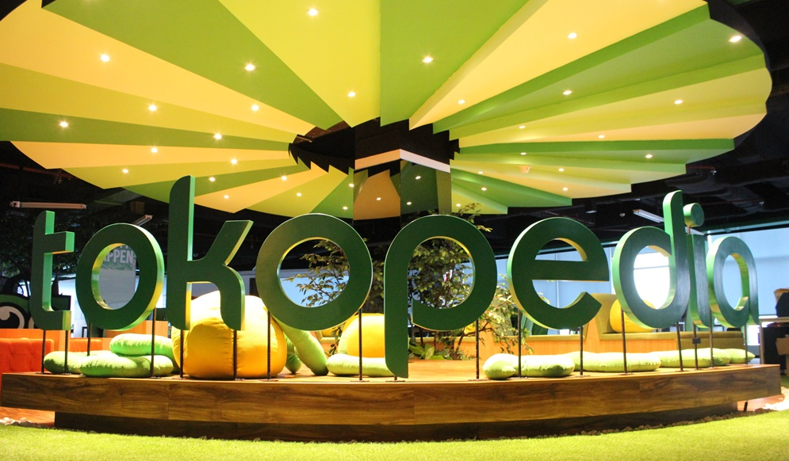
I N M O B I R E M A R K E T I N G
Dynamic Audience Builder
Accurately track and target users based on their
ever-changing states in the consumer lifecycle on mobile. Retarget app users in real-time based on in-app activity, purchase history and other personalized attributes
How does it work?
Dynamic Creative Optimizer
Leverage the combination of custom templates, personalized messages and rich creatives for delivering personalized messaging and recommendations to users; maximizing conversions.
InMobi Smartbidder
Efﬁcient remarketing spend with optimal bids for each user based on the advertiser’s goals. Accounting for over 50 attributes and post-click events, the SmartBidder computes the best bids for maximizing returns.
www.inmobi.com / insights@inmobi.com /
@InMobi

